Slide 1

Optimizing Climate Adaptation Strategies: A Multi-Objective Optimization Approach with MITRE | ADAPT™
Dhanuj Gandikota^{1,2}, Dr. Michael Szulczewski¹, Dr. Jeffrey Arnold³, Jenn Richkus¹, Ian Noble¹, Tasia Gladkova¹ |
¹The MITRE Corporation, ² The University of Texas at Austin, ³Earth Resources Technology (ERT)

Slide 2
Background and Research Problem
© 2024 THE MITRE CORPORATION. ALL RIGHTS RESERVED. APPROVED FOR PUBLIC RELEASE: PR_24-3818

Slide 3
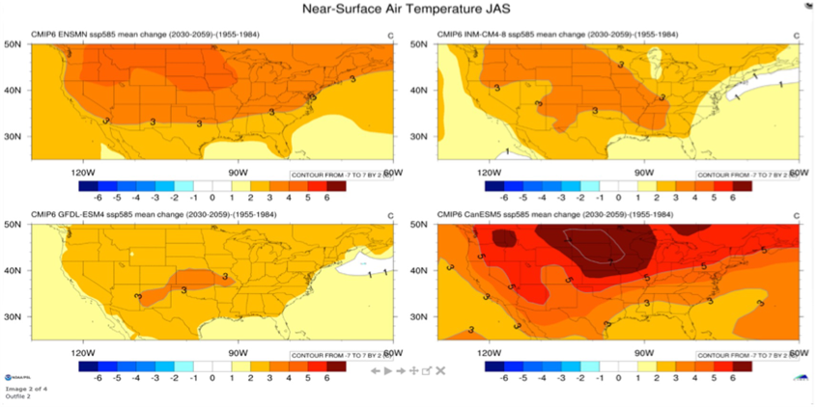
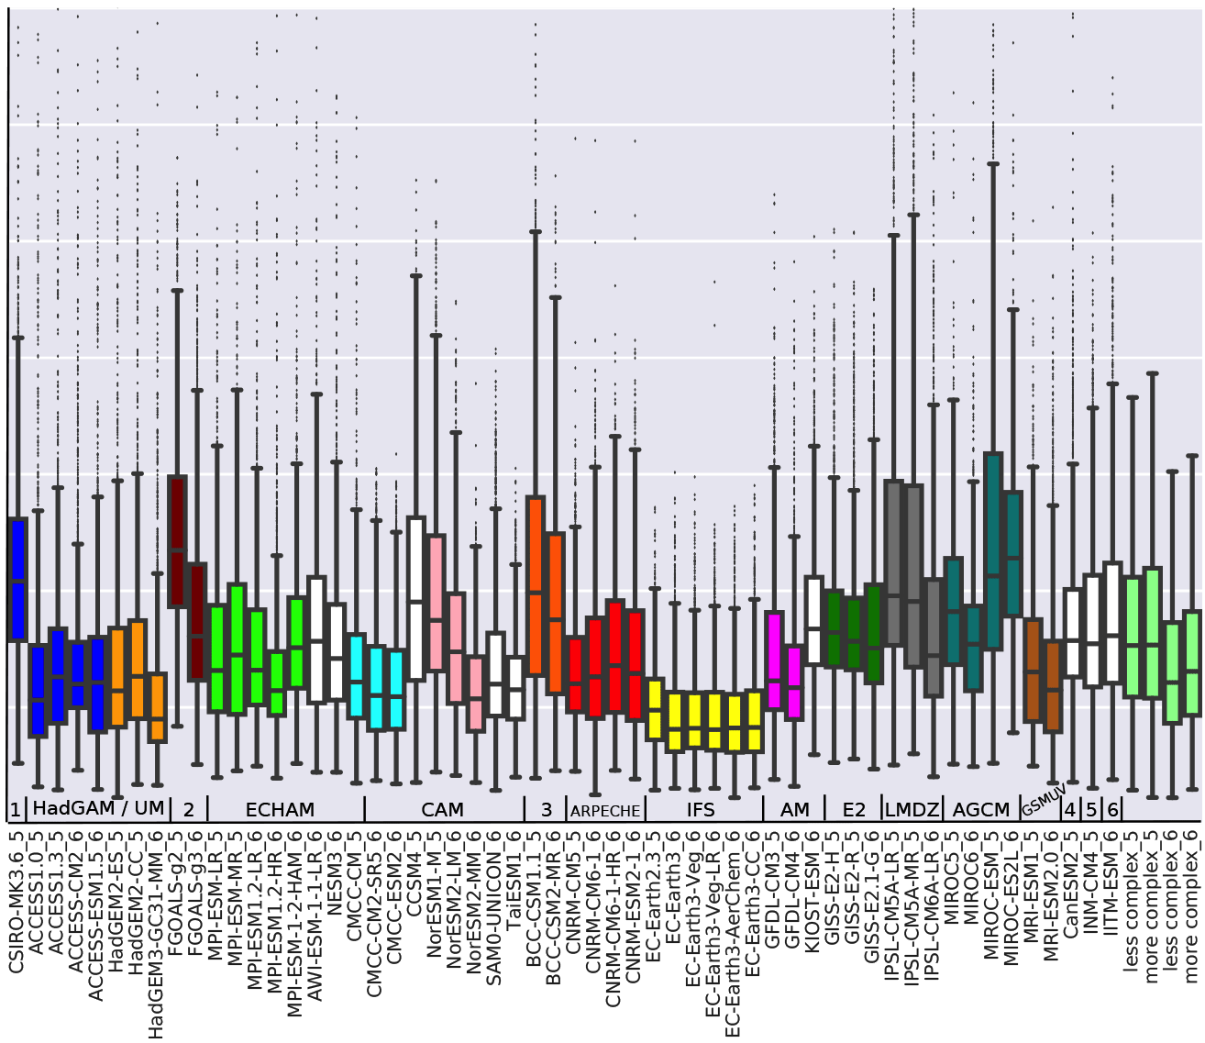
Complexity of Global Climate Models
“Variability in Projected North American Mean and Extreme Temperature and Precipitation Trends for the 21st Century: Model-To-Model Differences Versus Internal Variability”, 2023
“A circulation-based performance atlas of the CMIP5 and 6 models for regional climate studies in the Northern Hemisphere mid-to-high latitudes”, 2022
© 2024 THE MITRE CORPORATION. ALL RIGHTS RESERVED. APPROVED FOR PUBLIC RELEASE: PR_24-3818

Slide 4
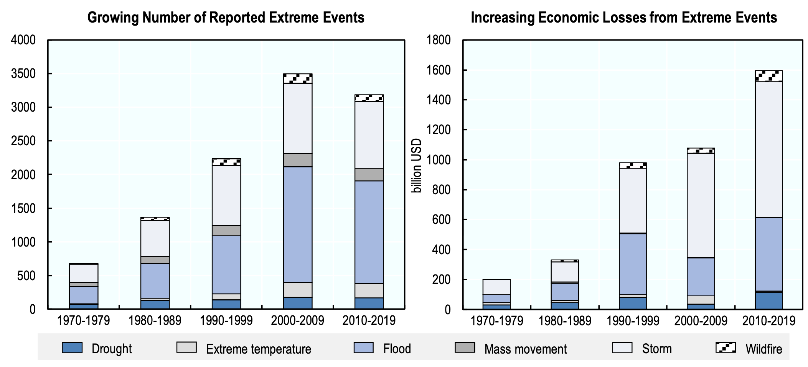
Extreme Climate Events & Hazards are Increasing
(OECD, 2024)
© 2024 THE MITRE CORPORATION. ALL RIGHTS RESERVED. APPROVED FOR PUBLIC RELEASE: PR_24-3818

Slide 5

Problem
No widely-used applications or tools that
Reduce the Complexity of Climate Models targeted to user’s jurisdiction
Integrate information across all stages of risk-and-response assessment
Contain uncertainty analysis and decision support for range of Climate Futures
Compare and Optimize Actionable Adaptation Strategies
(OECD, 2024)
© 2024 THE MITRE CORPORATION. ALL RIGHTS RESERVED. APPROVED FOR PUBLIC RELEASE: PR_24-3818

Slide 6
MITRE | ADAPT™ Framework and Solution
© 2024 THE MITRE CORPORATION. ALL RIGHTS RESERVED. APPROVED FOR PUBLIC RELEASE: PR_24-3818

Slide 7
MITRE | ADAPT™ Framework: Austin Case Study
The MITRE ADAPT™ software is designed as an end-to-end decision support tool for users to efficiently integrate analyses ​of climate-change risks, impacts, and adaptation response option sets for Infrastructure Resilience.
The ADAPT framework leverages climate sciences context with machine learning/big data analysis to provide actionable insights, supporting proactive climate adaptation tailored to stakeholder needs.
© 2024 THE MITRE CORPORATION. ALL RIGHTS RESERVED. APPROVED FOR PUBLIC RELEASE: PR_24-3818
Notes:
The MITRE ADAPT™ software is designed as an end-to-end decision support tool for users to efficiently integrate analyses ​of climate-change risks, impacts, and adaptation response option sets for Infrastructure Resilience.
The ADAPT framework leverages climate sciences context with machine learning/big data analysis to provide actionable insights, supporting proactive climate adaptation tailored to stakeholder needs.

Slide 8
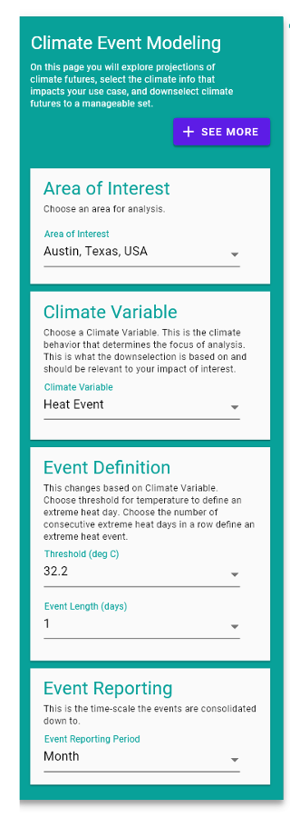
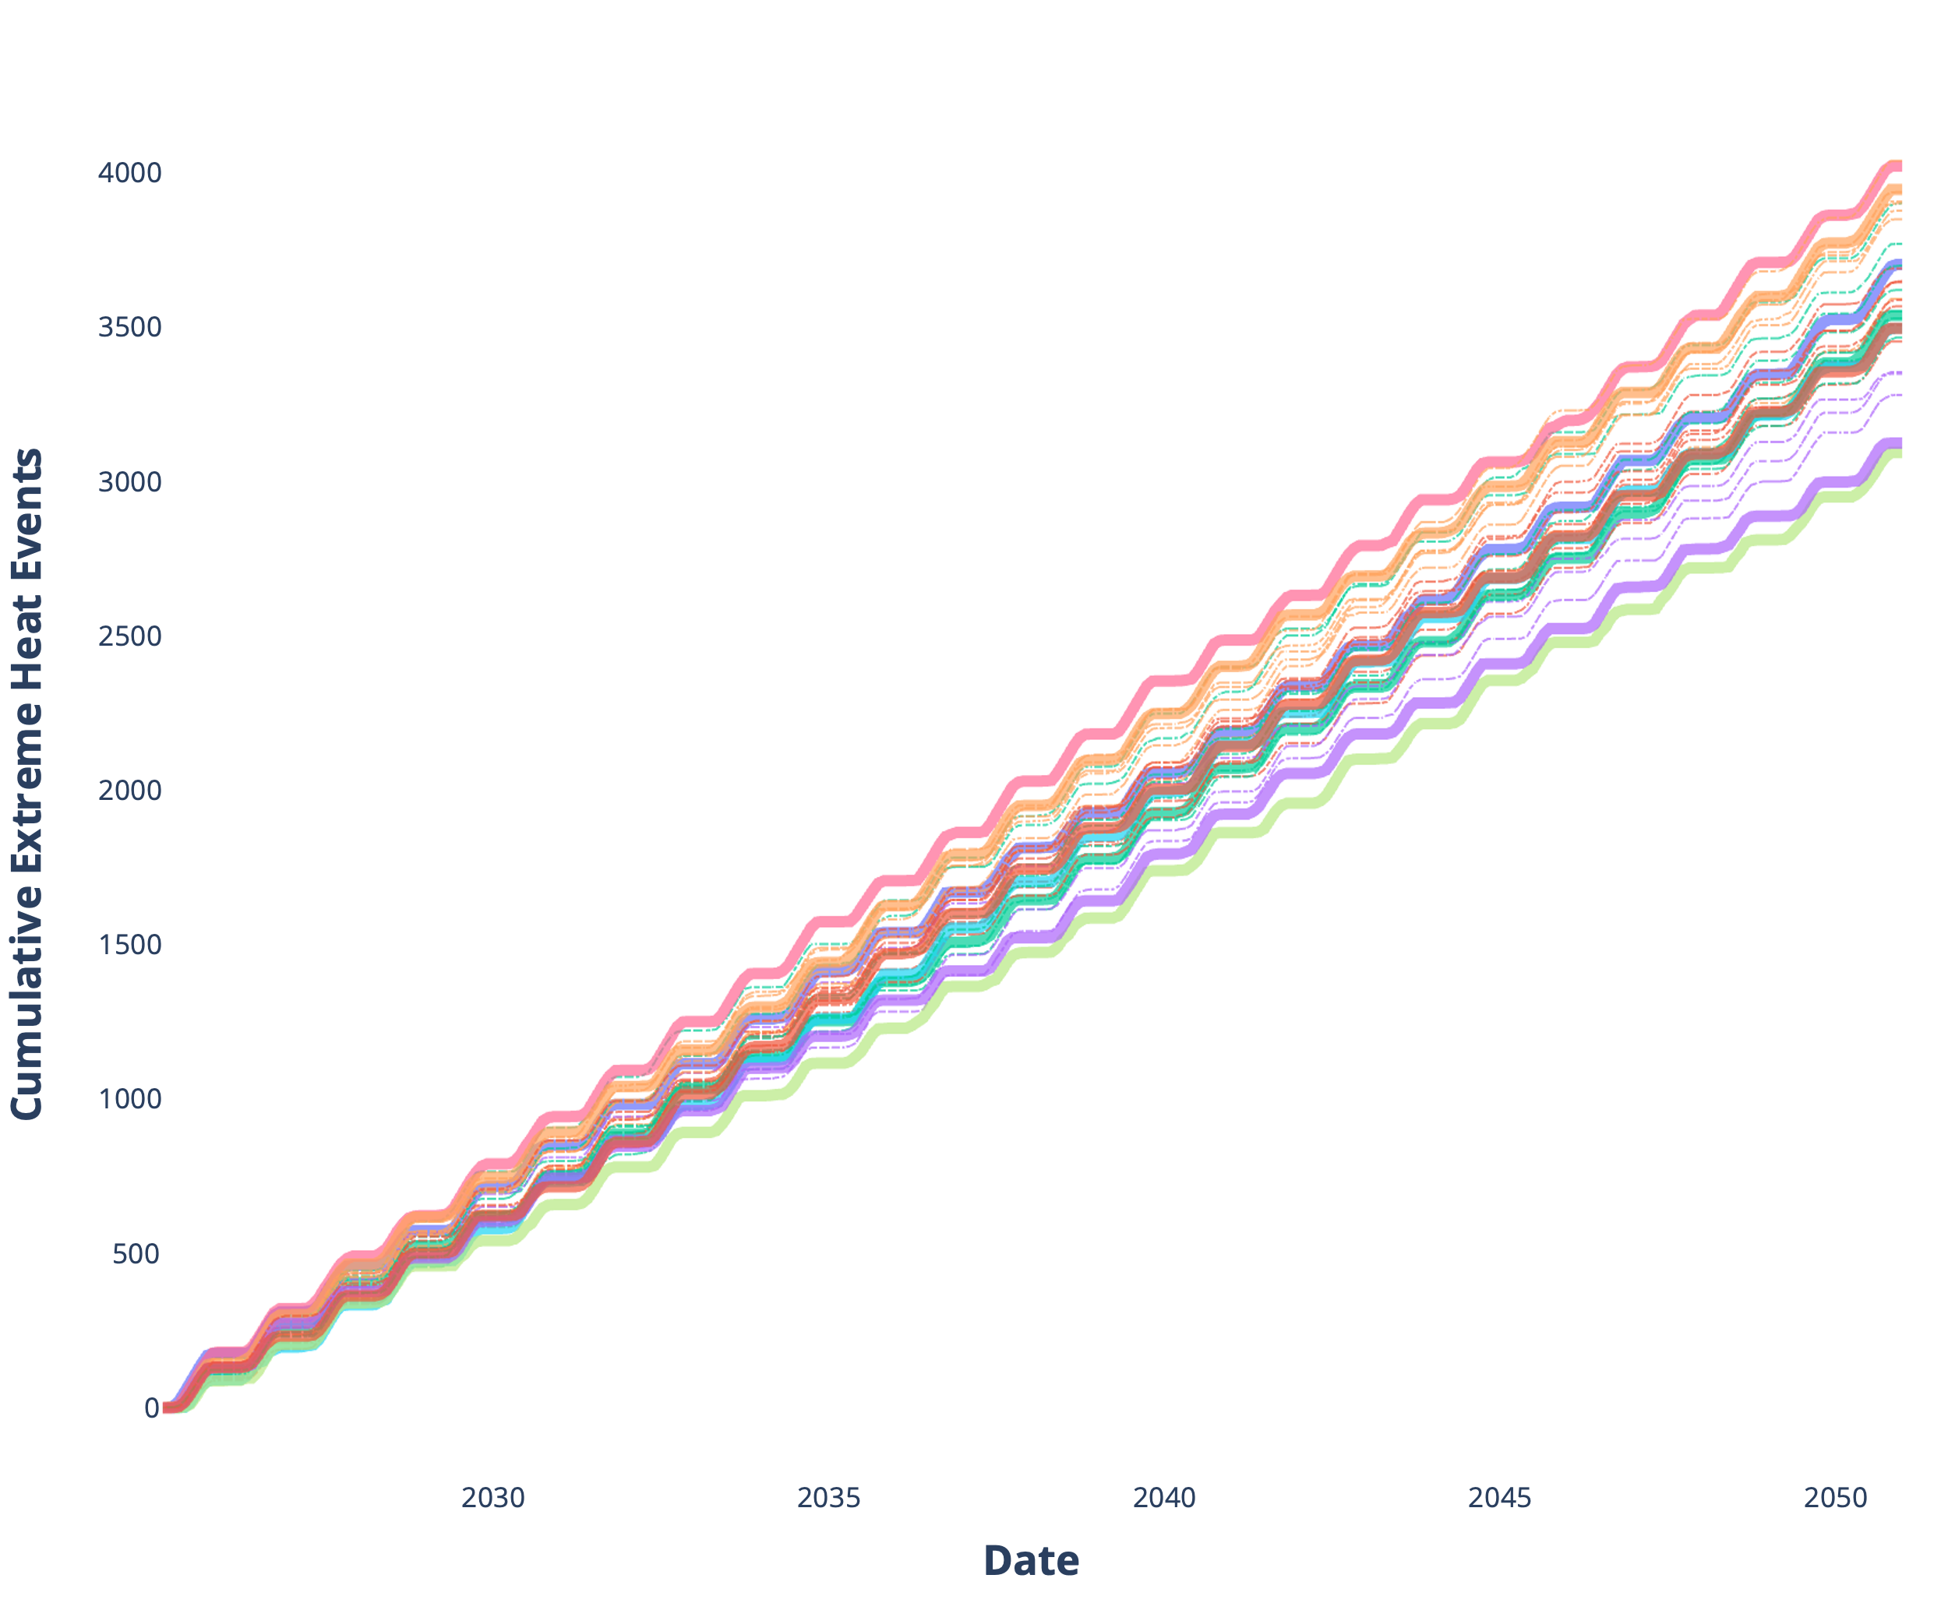
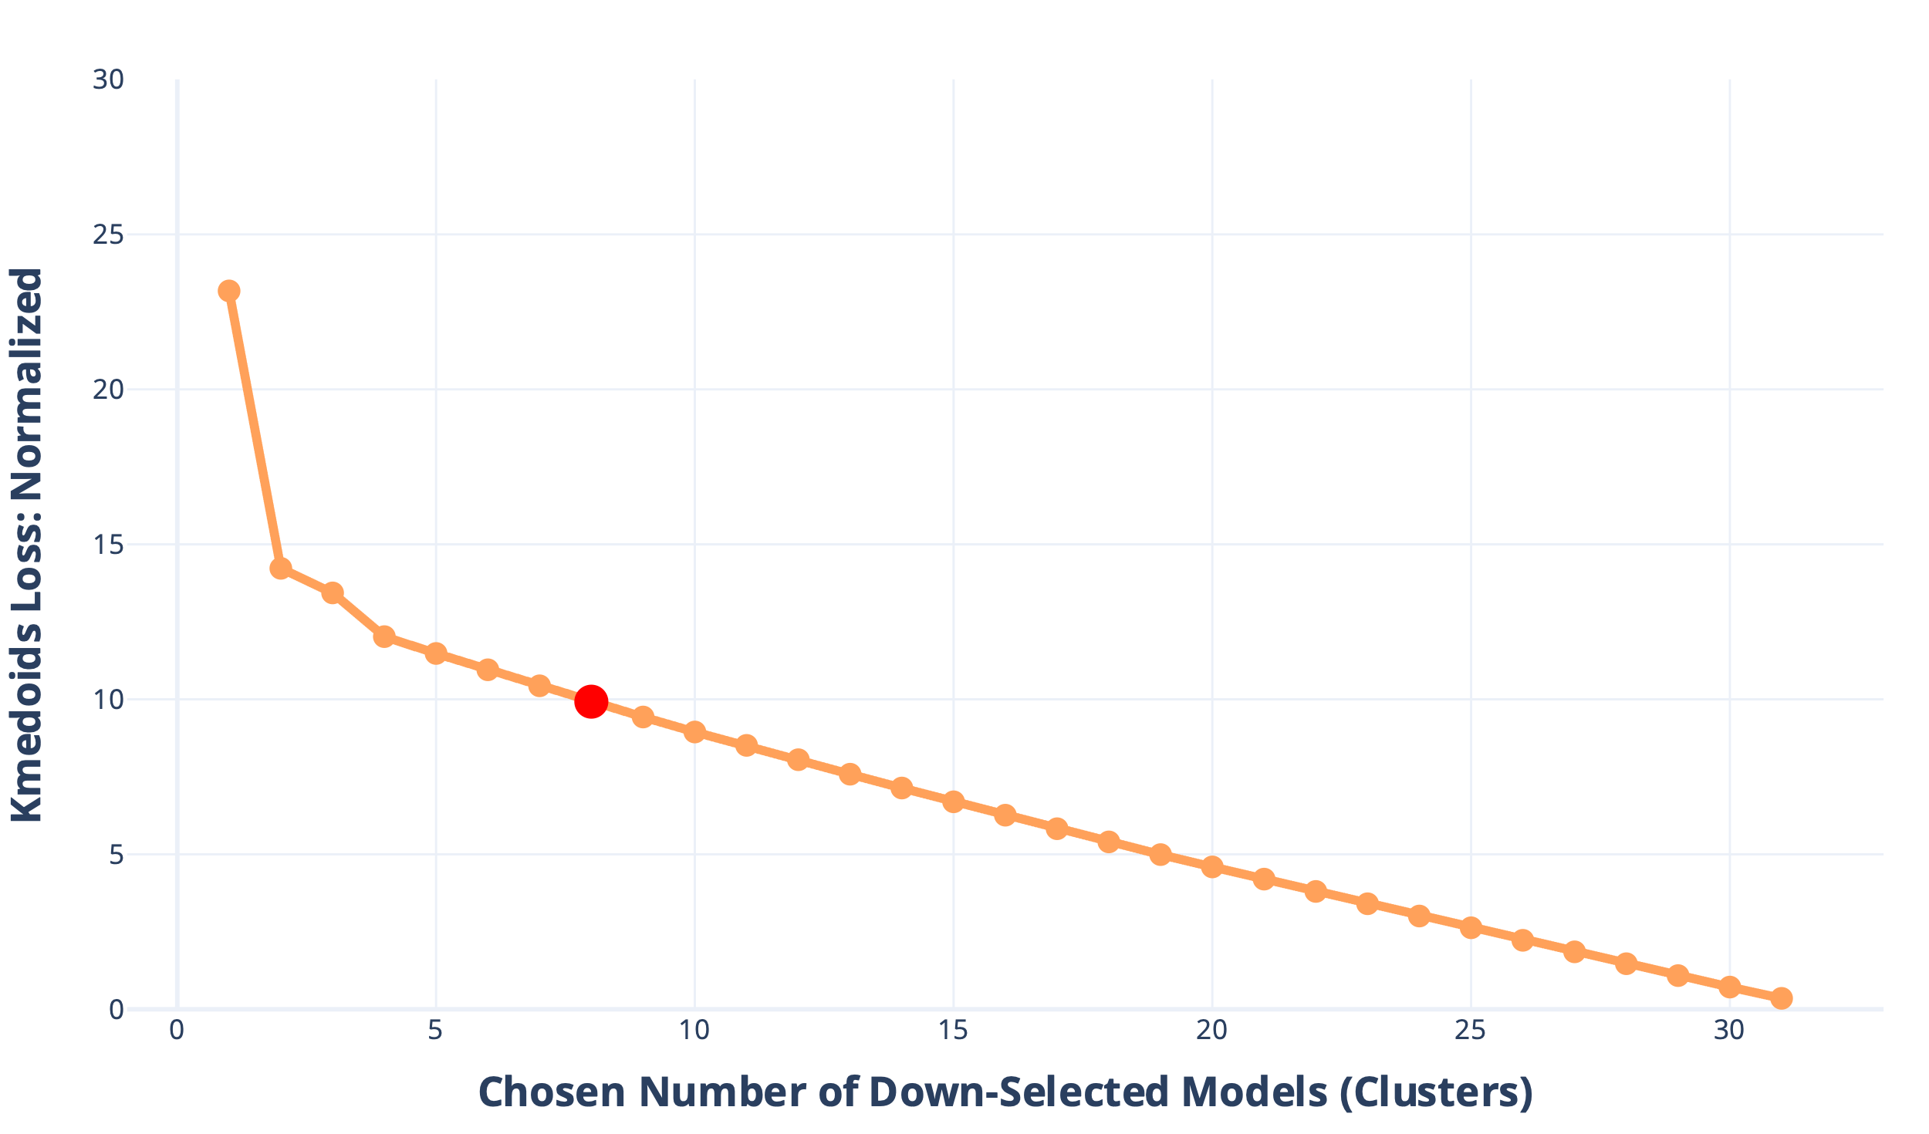
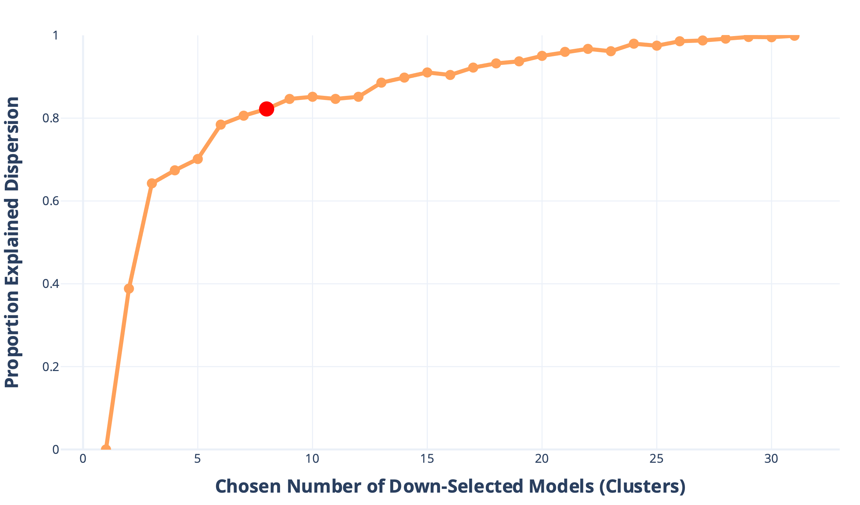
1. Tailored Climate Model Extraction & Down-Selection
ADAPT is fitted to utilize the global climate models from the the Coupled Model Intercomparison Project (CMIP). Our Tailored Climate Model Down-Selection framework is designed to leverage user context targeted for the climate event and region of interest.
Low Complexity, & High Interpretability
Computational Efficiency
Minimizes Uncertainty in Ensemble Representation & Diversity
© 2024 THE MITRE CORPORATION. ALL RIGHTS RESERVED. APPROVED FOR PUBLIC RELEASE: PR_24-3818

Slide 9
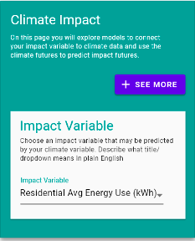
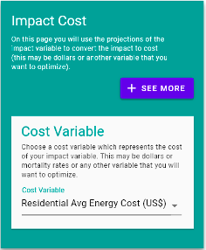
2. Vulnerability & Exposure Modeling
ADAPT works with the user’s interests to pinpoint the direct vulnerabilities and exposure impacts of climate events within a decision maker's jurisdiction. It then calculates the associated costs for each exposure impact, enabling strategic decision-making.
To assess impacts, ADAPT considers various variables per jurisdiction, such as residential energy usage, population projections, and electric charge rate tiers. It then applies a varied cohort of Physics-Based and ML modeling algorithms, like Time Series Auto-Arima Forecasting, to predict future trends of those variables
© 2024 THE MITRE CORPORATION. ALL RIGHTS RESERVED. APPROVED FOR PUBLIC RELEASE: PR_24-3818
Notes:
ADAPT works with the user’s interests to pinpoint the direct vulnerabilities and exposure impacts of climate events within a decision maker's jurisdiction. It then calculates the associated costs for each exposure impact, enabling strategic decision-making.
To assess impacts, ADAPT considers various variables per jurisdiction, such as residential energy usage, population projections, and electric charge rate tiers. It then applies a varied cohort of Physics-Based and ML modeling algorithms, like Time Series Auto-Arima Forecasting, to predict future trends of those variables

Slide 10
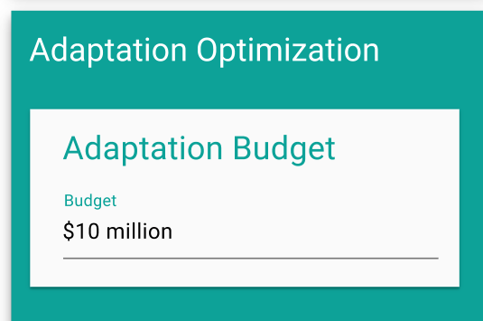
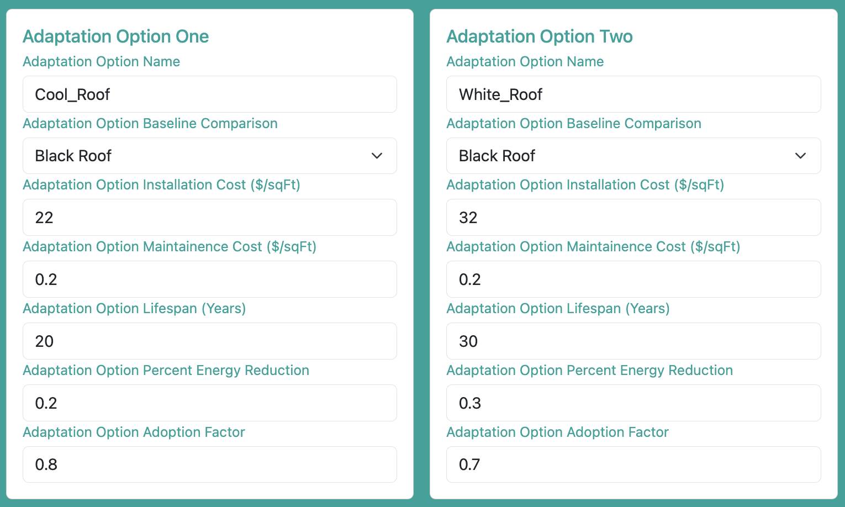
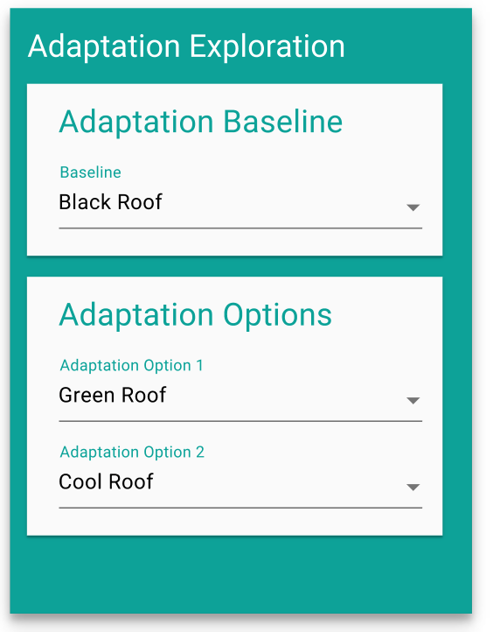
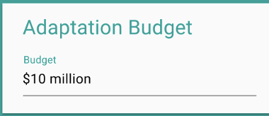
3a. Adaptation Response Modeling
How to compare cool-roofing adaptation responses for Austin, TX?
Adaptation Options
Decisionmaker
Constraints
Constraints
Green Roof
$50 million
Black Roof
172
Green Roof has 2x Rate of Energy Reduction than White Roof, but 3x installation cost and much higher maintenance costs
Subsidy
2.9
0.25
White Roof
40
Evaluation
Green Roof
0.4
70 Years
1.2
© 2024 THE MITRE CORPORATION. ALL RIGHTS RESERVED. APPROVED FOR PUBLIC RELEASE: PR_24-3818

Slide 11
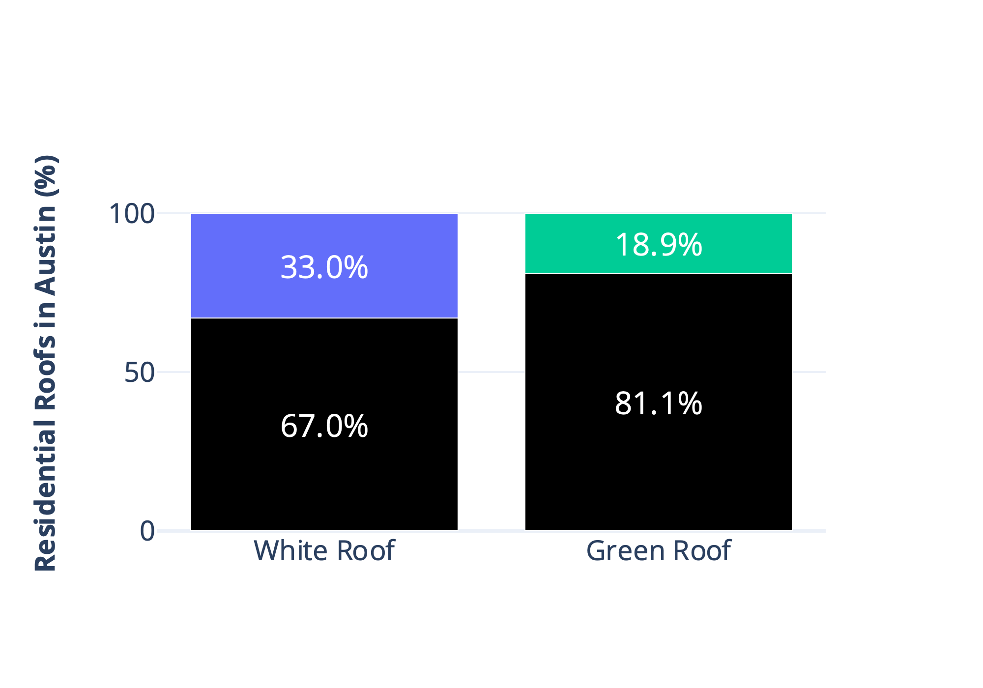
3a. Adaptation Response Modeling
Constraints
Green Roof
Black Roof
172
$50 million
2.9
40
Subsidy
0.4
0.25
1.2
Evaluation
White Roof
70 Years
Black Roof
50
0.2
20
0.2
1.0
ADAPT models adaptations into Vulnerability and Exposure Impacts with the rate of energy reduction (only applied in months with Extreme Heat Events)
© 2024 THE MITRE CORPORATION. ALL RIGHTS RESERVED. APPROVED FOR PUBLIC RELEASE: PR_24-3818

Slide 12
Multi-Objective Optimization Approach for Optimizing Climate Adaptation Strategies
© 2024 THE MITRE CORPORATION. ALL RIGHTS RESERVED. APPROVED FOR PUBLIC RELEASE: PR_24-3818

Slide 13
Multi-Objective Optimization Approach
Adaptation Optimization Problem
Goal: Formulate and solve a multi-objective optimization problem, aiming to identify a set of optimal design points that balance competing objectives given decisionmaker adaptation actions and constraints.
Design Variables and Objective Space: Define a set of controllable input parameters (design variables) that characterize actionable climate adaptation actions and map these variables through a system model into a vector of output metrics (objectives) whose values must be simultaneously optimized.
Element-Wise Approach: Employ an element-wise approach in the Pymoo Python library, where each component of the objective is evaluated independently for every candidate adaptation solution.
This facilitates flexible and fine-grained handling of multiple objectives, enabling more complex, non-uniform transformations or constraints to be applied individually to each adaptation objective.
NSGA2 Algorithm: Utilize the well established NSGA2 evolutionary algorithm, which uses a population-based search, non-dominated sorting, and crowding distance metrics to efficiently explore the design space and produce a diverse set of Pareto-optimal solutions.
What percent of cool-roof installation costs should the gov’t. subsidize in Austin, TX?
Design Variables
Government Installation Subsidy Proportion
Objective Space
Minimize Government Expenditure ($)
Maximize Austin City Residential Cost Savings($)
© 2024 THE MITRE CORPORATION. ALL RIGHTS RESERVED. APPROVED FOR PUBLIC RELEASE: PR_24-3818
Notes:
Pareto Optimal: A solution (or set of design variables) is considered Pareto optimal if it cannot be improved in any one objective without causing a deterioration in at least one other objective. In other words, no other solution in the search space strictly outperforms it on all fronts. Pareto optimality represents a state where any movement away from that solution would entail trading off one objective against another.
Pareto Front: The Pareto front is the collection of Pareto optimal solutions in the objective space. It forms the boundary separating solutions that are attainable and represent the best compromises among conflicting objectives from those that are not. Graphically, in two-objective problems, this front often appears as a curve (or surface in higher dimensions) along which any further improvement in one objective would necessitate some sacrifice in at least one other objective

Slide 14
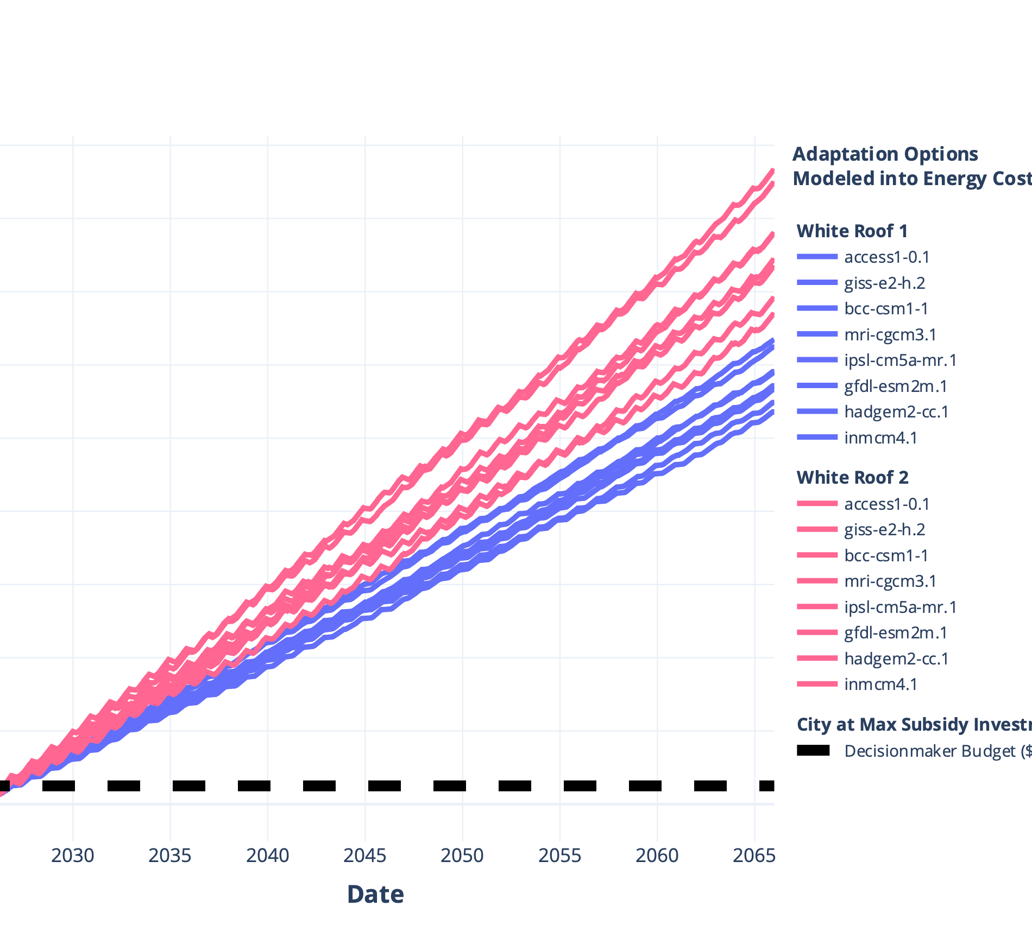
Case Study: Adaptation Optimization for White Roofing in Austin
The Multi-Objective Optimization Approach allows to simplify adaptation strategies and project complex adaptation parameters and constraints between options
White Roof 2 has 2x materials cost but 2x energy reduction efficiency
Constraints
White Roof 1
White Roof 2
Black Roof
Black Rood
$50 million
25
50
Subsidy
*Projected Cost Savings if Subsidy amounts were same for each. Max is $580 million
0.2
0.2
*Optimized For Each
20
20
Evaluation
0.2
0.4
40 Years
1.0
1.0
© 2024 THE MITRE CORPORATION. ALL RIGHTS RESERVED. APPROVED FOR PUBLIC RELEASE: PR_24-3818

Slide 15
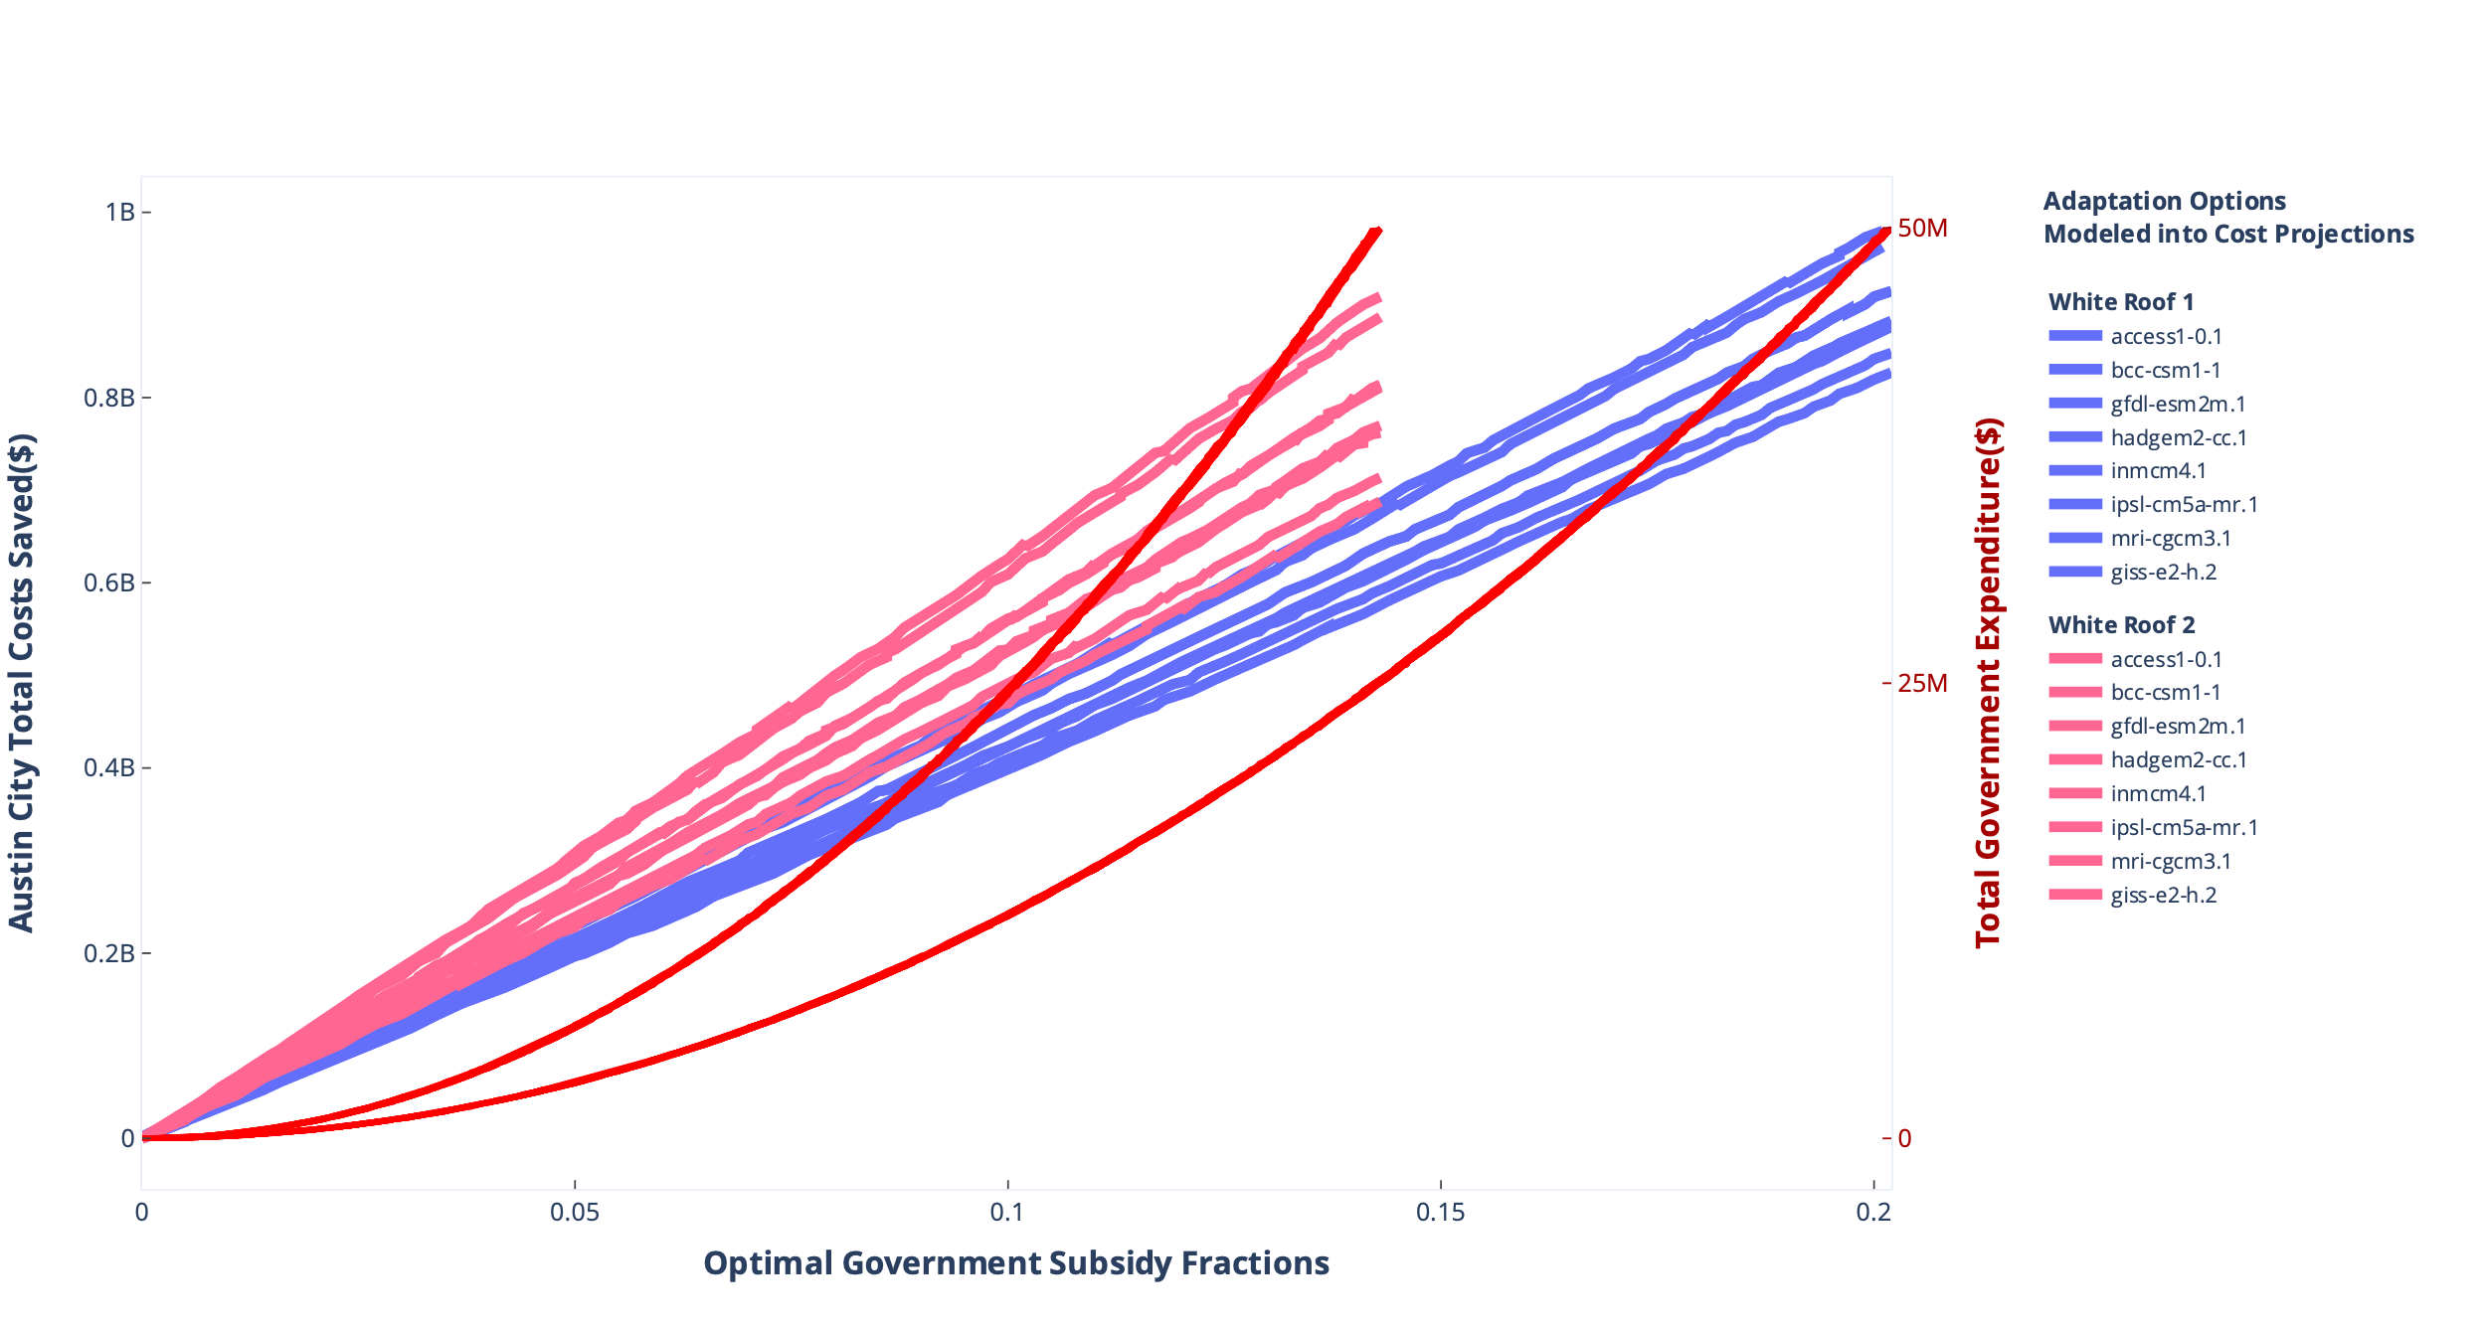
Case Study: Adaptation Optimization for White Roofing in Austin
Each Option’s Optimal Austin City Costs Saved and Government Cost at each Subsidy Level
White Roof 1
White Roof 2
Black Roof
Black Roof
25
50
0.2
0.2
20
20
0.2
0.4
1.0
1.0
Constraints
$50 million
Subsidy
*Optimized For Each
*Increase of ~$200-400 million saved compared to prior static subsidy amounts
Evaluation
40 Years
© 2024 THE MITRE CORPORATION. ALL RIGHTS RESERVED. APPROVED FOR PUBLIC RELEASE: PR_24-3818

Slide 16
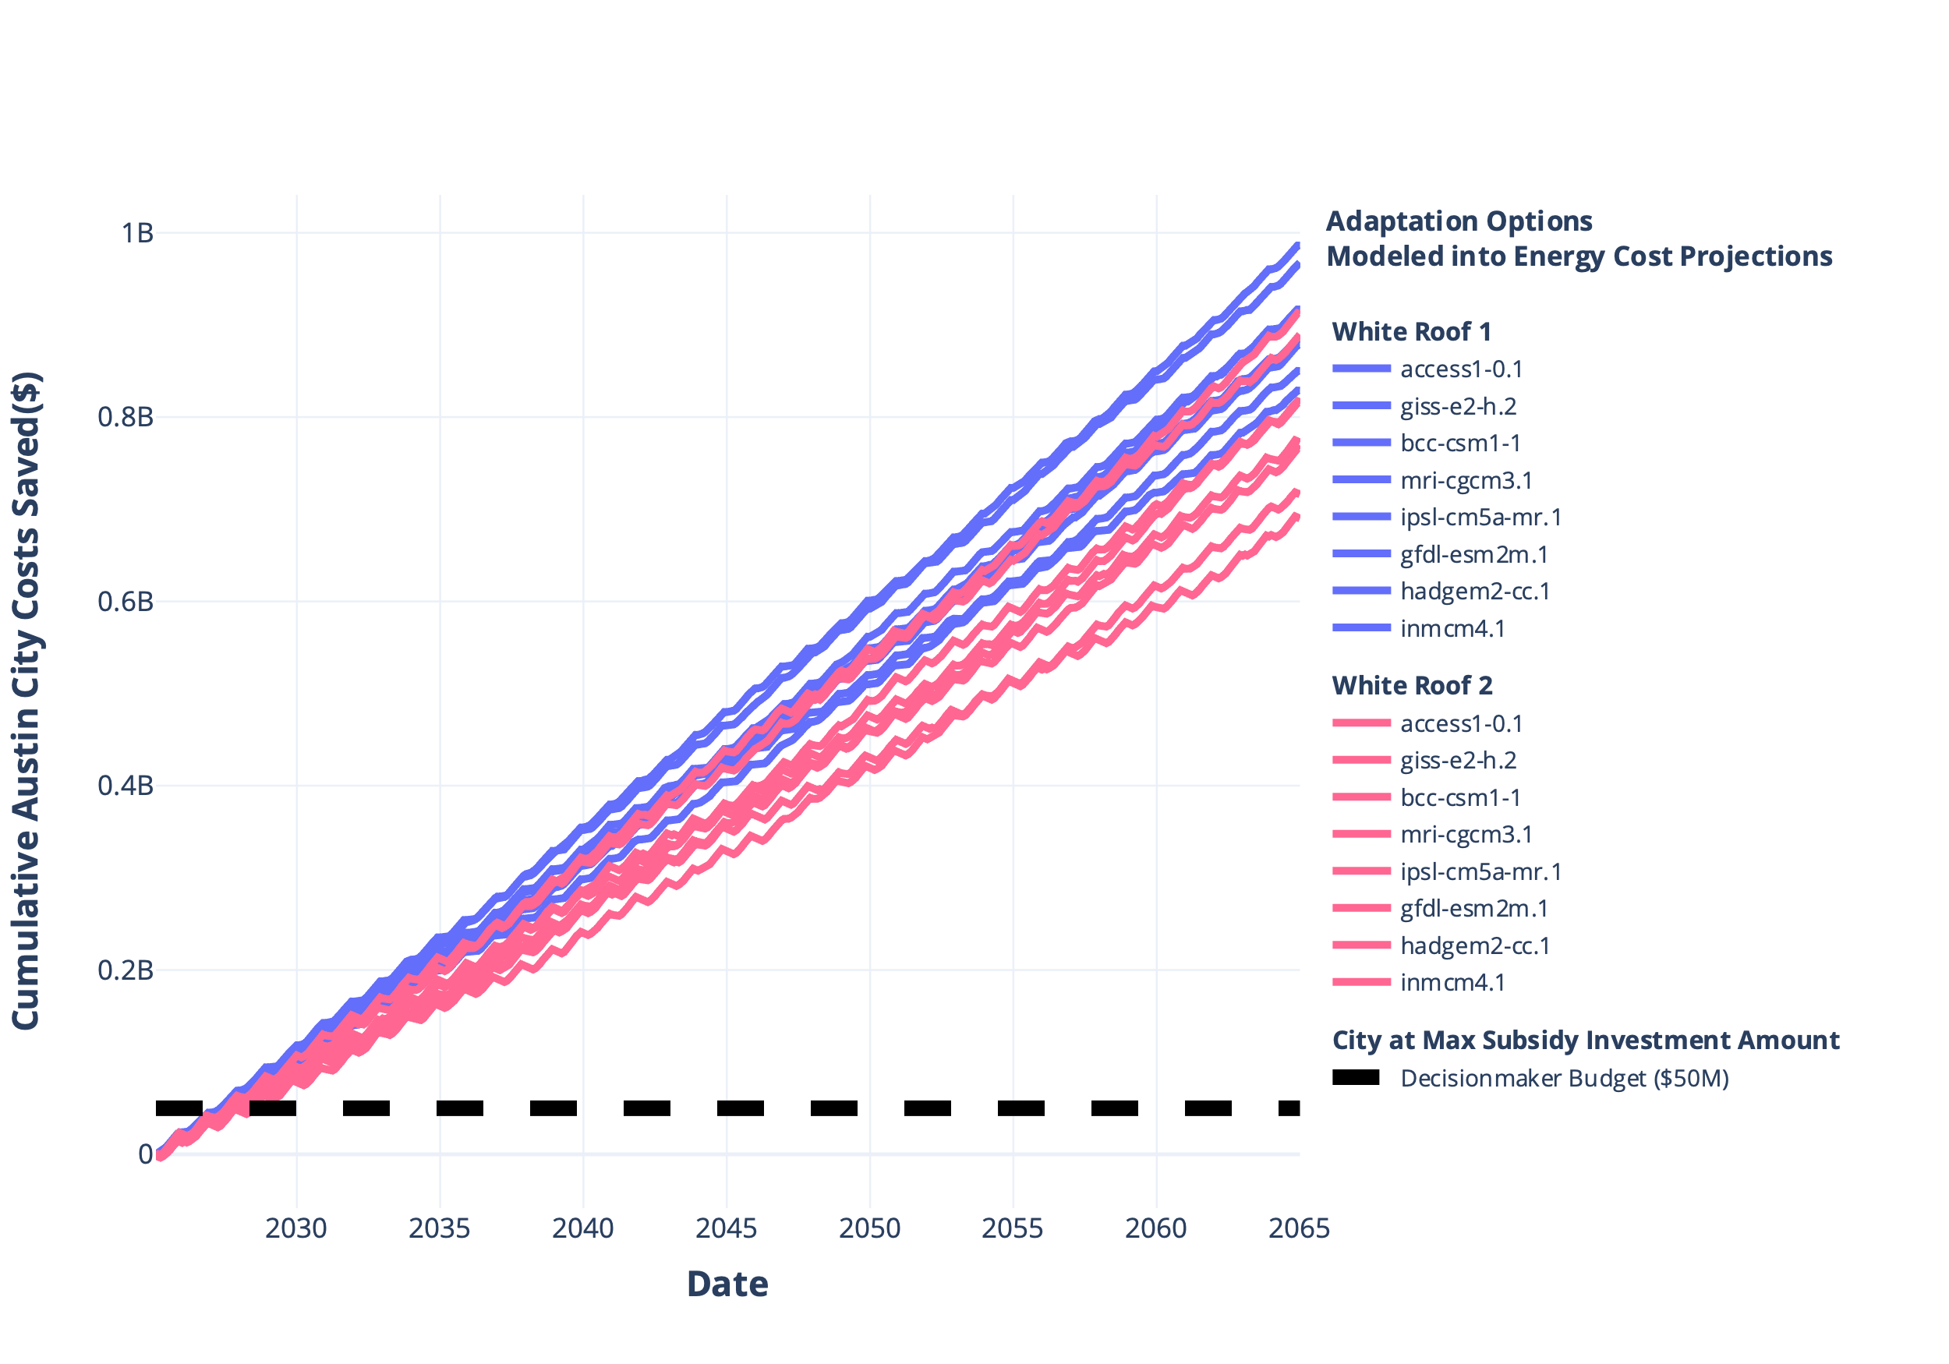
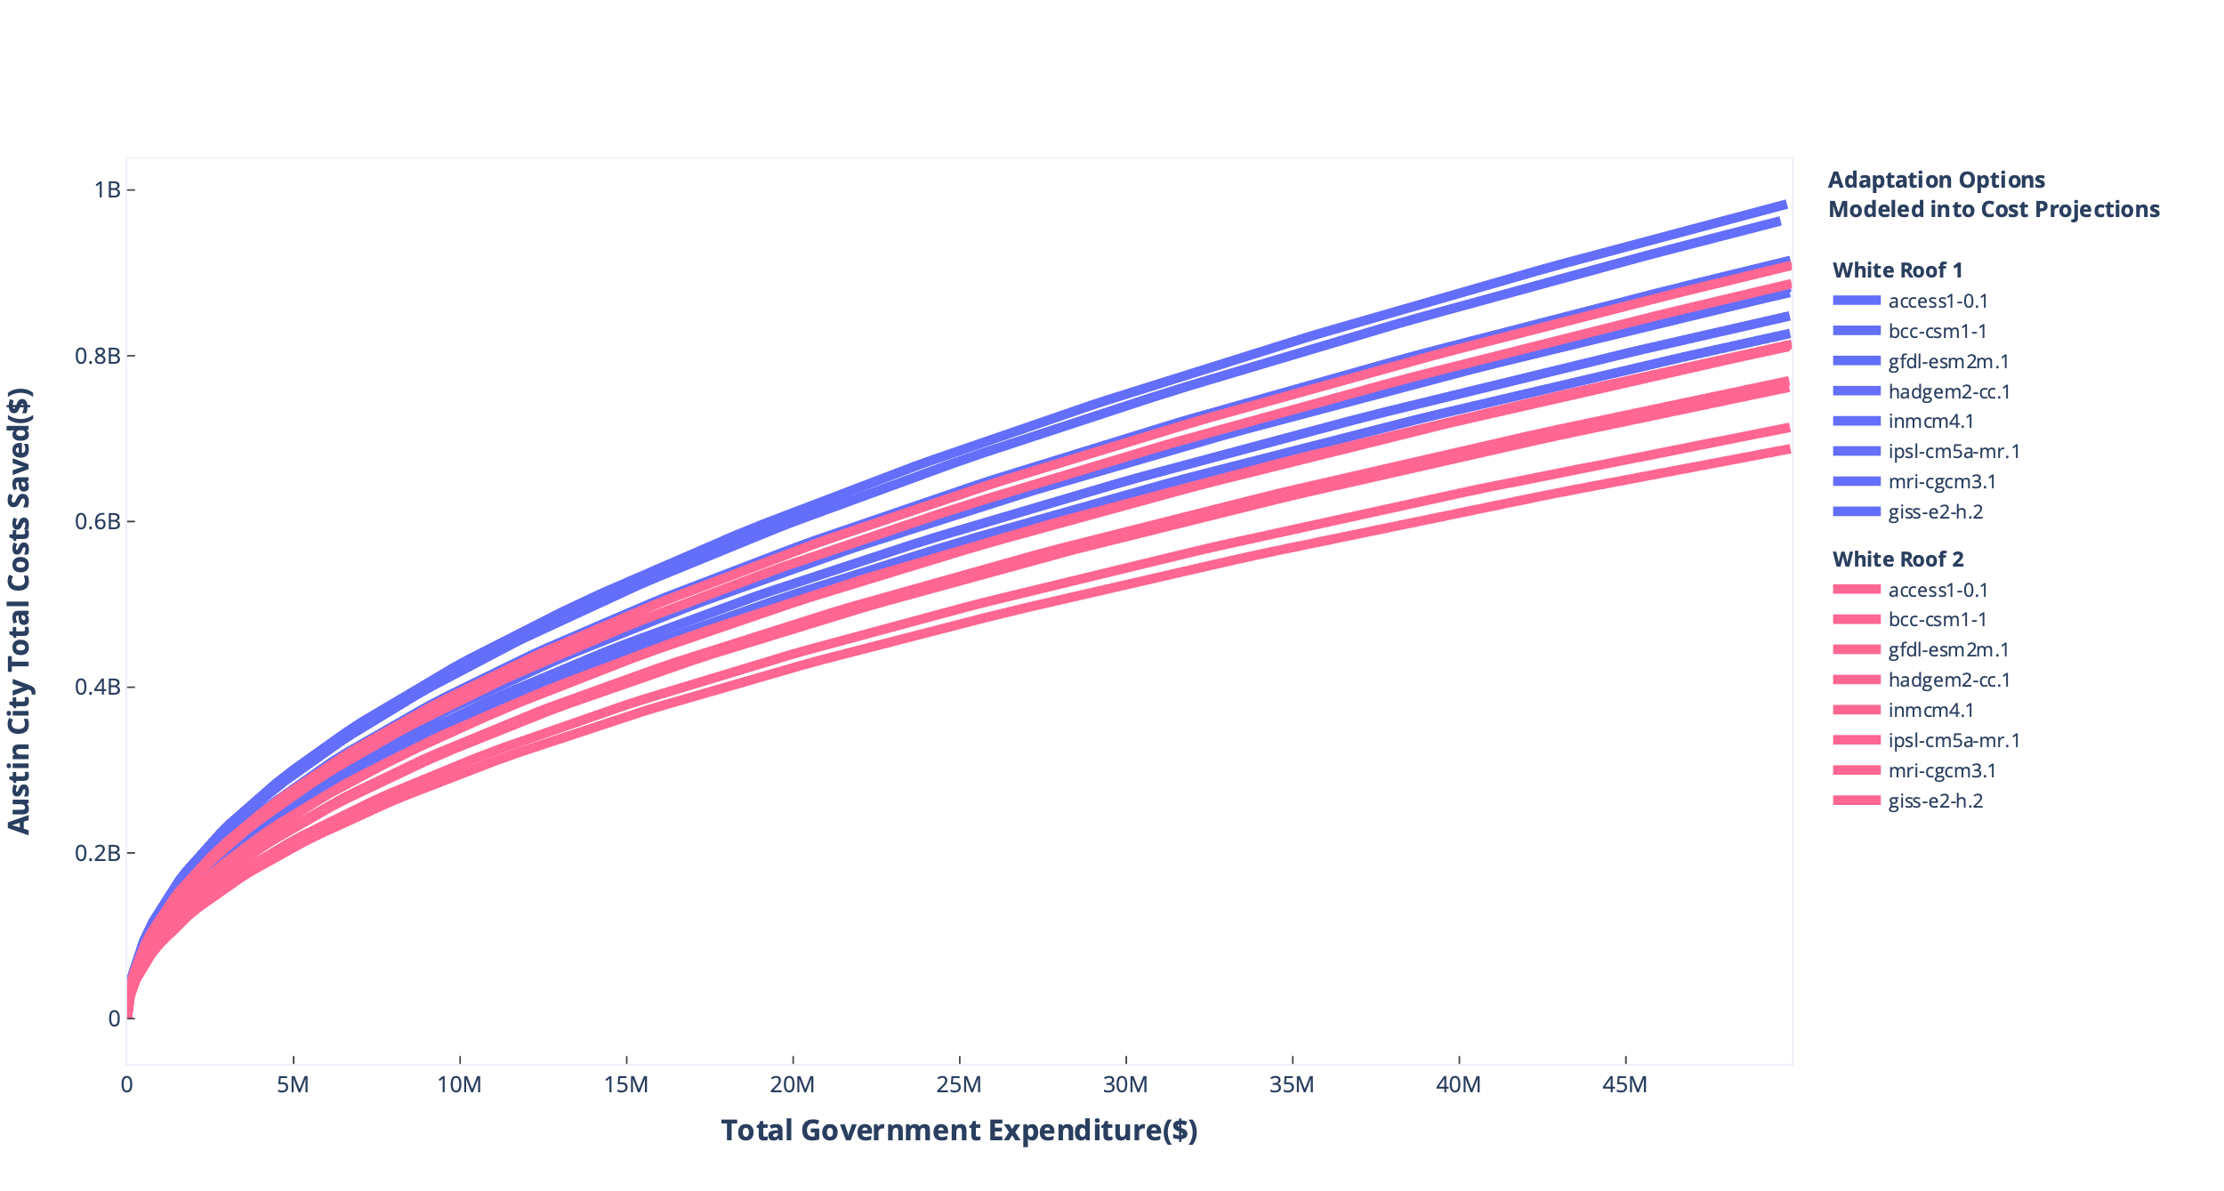
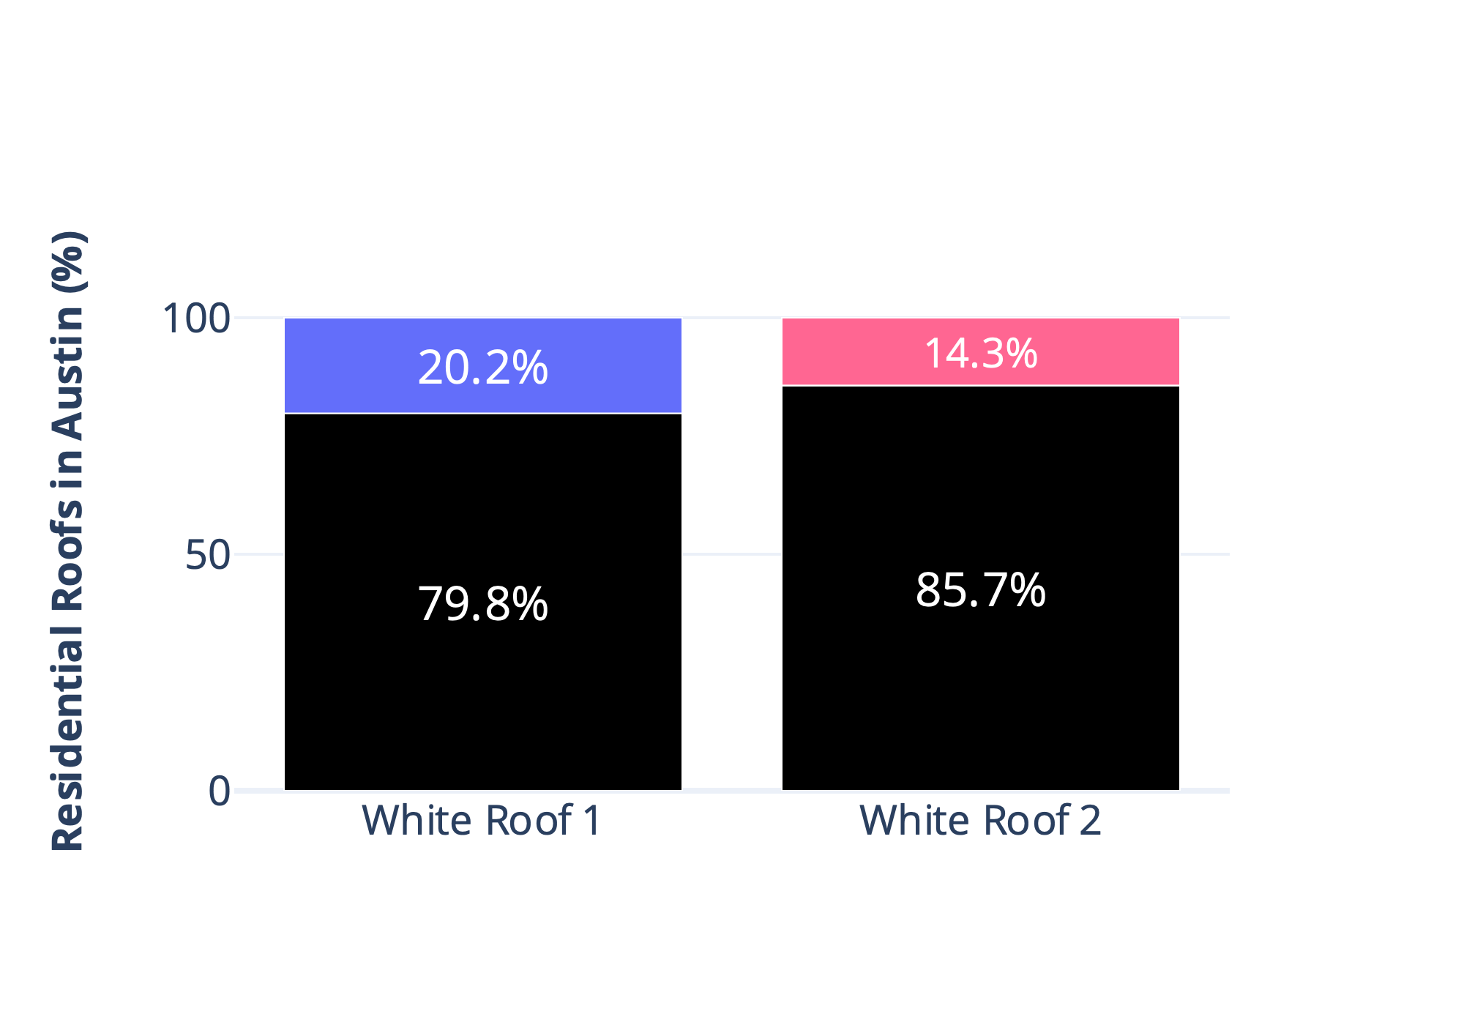
Case Study: Adaptation Optimization for White Roofing in Austin
Austin Costs Saved Projections
For Optimal Subsidy at Maximum Government Expenditure
Austin Costs Saved at each level of Govt Expenditure
Optimal Subsidy can/will be different for each point
© 2024 THE MITRE CORPORATION. ALL RIGHTS RESERVED. APPROVED FOR PUBLIC RELEASE: PR_24-3818

Slide 17
Summary
The ADAPT System demonstrates potential in
Reducing the Complexity of Climate Models targeted to user’s jurisdiction
Integrating information across all stages of risk-and-response assessment
Containing uncertainty analysis and decision support for range of Climate Futures
ADAPT’s Multi Objective Optimization Approach demonstrates potential in
Comparing and Optimizing Actionable Adaptation Strategies
Accommodating Decisionmaker Constraints within optimization
Integrating into complex Climate Modeling and Adaptation Pipelines
© 2024 THE MITRE CORPORATION. ALL RIGHTS RESERVED. APPROVED FOR PUBLIC RELEASE: PR_24-3818

Slide 18
Next Steps
Further ADAPT Case Studies: Test efficacy of optimization methods across varied spatiotemporal scales, climate events/hazards, and specific adaptation options.
Enhance Optimization Algorithms: Test and compare Multi-Objective Optimization approaches with different optimization algorithms, greater design variables, and machine-learning based approaches (if adaptation dataset provides the opportunity).
© 2024 THE MITRE CORPORATION. ALL RIGHTS RESERVED. APPROVED FOR PUBLIC RELEASE: PR_24-3818

Slide 19
Contact us for any further questions or Partnerships
We would love to test ADAPT within your climate adaptation research, needs, or use cases!
ADAPT:
dgandikota@mitre.org, mszulczewski@mitre.org, jasrichkus@mitre.org
https://www.linkedin.com/in/dhanujg

Slide 20
End
© 2024 THE MITRE CORPORATION. ALL RIGHTS RESERVED. APPROVED FOR PUBLIC RELEASE: PR_24-3818

Slide 21
Figure References
OECD, 2024. Infrastructure for a Climate-Resilient Future. OECD Publishing, Paris. https://doi.org/10.1787/a74a45b0-en
Calvin et al., 2023. IPCC, 2023: Climate Change 2023: Synthesis Report. Contribution of Working Groups I, II and III to the Sixth Assessment Report of the Intergovernmental Panel on Climate Change [Core Writing Team, H. Lee and J. Romero (eds.)]. IPCC, Geneva, Switzerland. Intergovernmental Panel on Climate Change (IPCC). https://doi.org/10.59327/IPCC/AR6-9789291691647
Liu, K., Wang, Q., Wang, M., Koks, E.E., 2023. Global transportation infrastructure exposure to the change of precipitation in a warmer world. Nat Commun 14, 2541. https://doi.org/10.1038/s41467-023-38203-3
© 2024 THE MITRE CORPORATION. ALL RIGHTS RESERVED. APPROVED FOR PUBLIC RELEASE: PR_24-3818

